Slide 1
IoT Based Optimal Coordination of Protective Devices for FREEDM System

Slide 2
Supervisors
Prof. Dr. : Magdi M. El-Saadawi
Electrical Engineering Department
Faculty of Engineering
Mansoura University
Dr. Bishoy E. Sedhom Beshay
Electrical Engineering Department
Faculty of Engineering
Mansoura University
.

Slide 3



Slide 4
Today’s Agenda
first
second
third
last
Introduction to FREEDM
Solid State Transformer
Protection Schemes
IoT Prototype
What, Why & How?
Proposed Design & Implementation as well as Simulation Analysis.
Differential & Over Current Protection.
Internet of Things Features. Prototype Simulation.

Slide 5
Introduction
1
What is FREEDM Smart Grid?

Slide 6
Smart Grid
Electrical grid that's integrated with a computerized, two-way communication network.
Real-time monitoring modify and tune itself to an optimal state of performance.
Renewable energy ultimate integration.

Slide 8
FREEDM
The rise of renewable energy & computerized optimization.

Slide 9
Notes:
Talk about : IOT DESD + DRER

Slide 10
We can split the main functionality:
Distributed Grid Intelligence
System brain. Centralized command and control unit.
Fault Isolation Device
Computerized protection relay unit.
Solid State Transformer
Collection of flexible high-powered semiconductors.
Notes:
بخلاصة كده , كل اللي فات نقدر نقول ان أهم 3 عناصر هما :

Slide 11
Solid State Transformer
2
Proposed Design and Implementation.

Slide 12
SST Features
Allows two-way power flow .
AC or DC power as Input or output.
Actively change power characteristics such as voltage and frequency levels.
Improve power quality (reactive power compensation and harmonic filtering).

Slide 13

MATLAB Simulink
Libraries of predefined blocks for modeling continuous-time and discrete-time system.
Scopes and data displays for viewing simulation results.
Simulation engine with fixed-step and variable-step ODE solvers.

Slide 14
Notes:
4 / 5 / 6 stages , we chose the 3

Slide 15
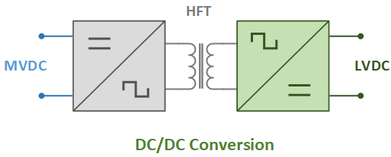
Stage 2 DC-DC
The DC-AC sub-stage inverts and generates high frequency to (HFT).
The AC-DC sub-stage rectifies the output current of the HFT.

Slide 16
Notes:
4 / 5 / 6 stages , we chose the 3

Slide 17
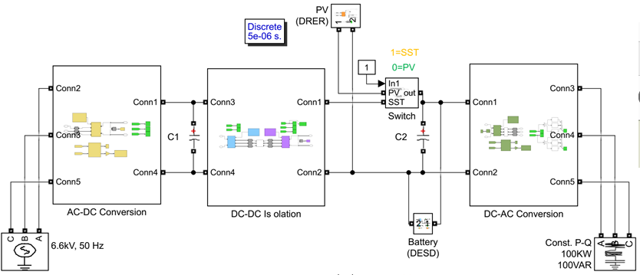

Slide 18
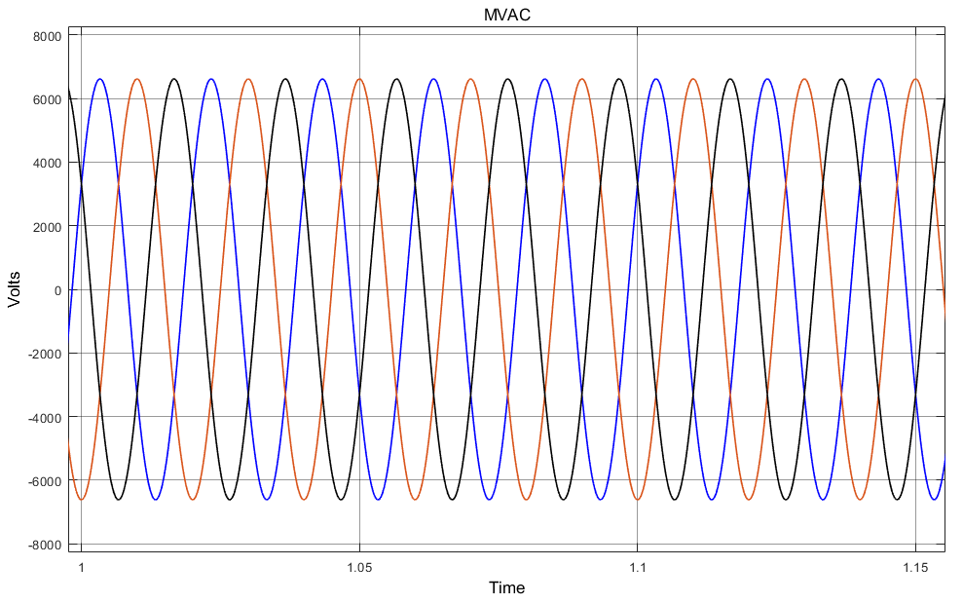
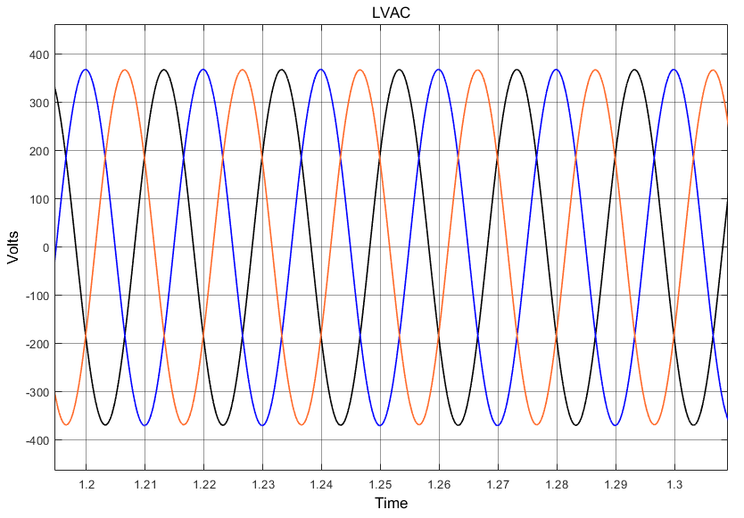
SST Stand-alone Results
Stage 1 Stage 3

Slide 19
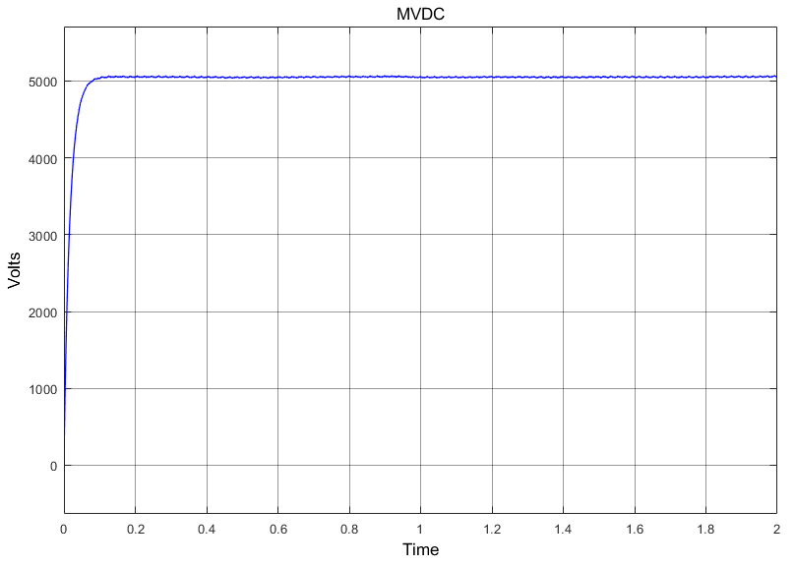
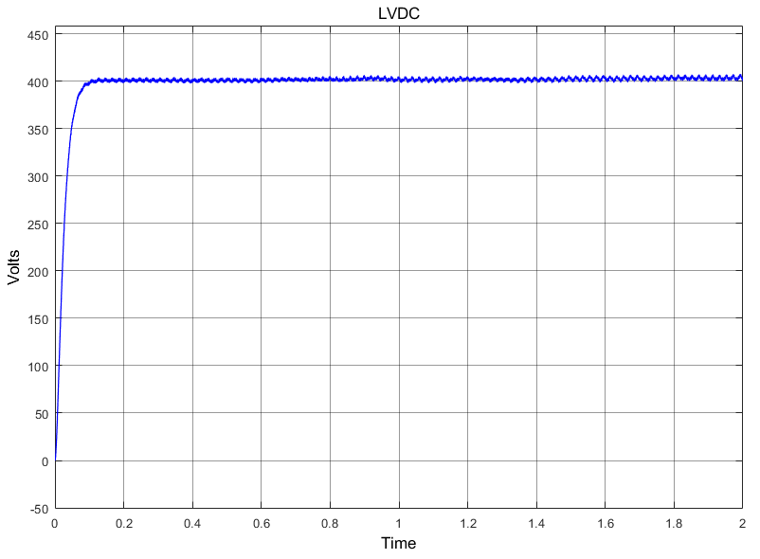
SST Stand-alone Results
Stage 2 Stage 2

Slide 20
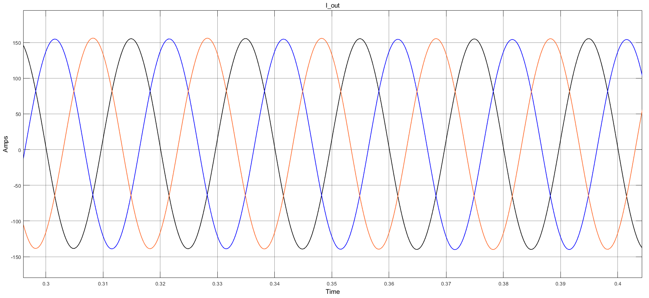
SST Stand-alone Results
Stage 3

Slide 21
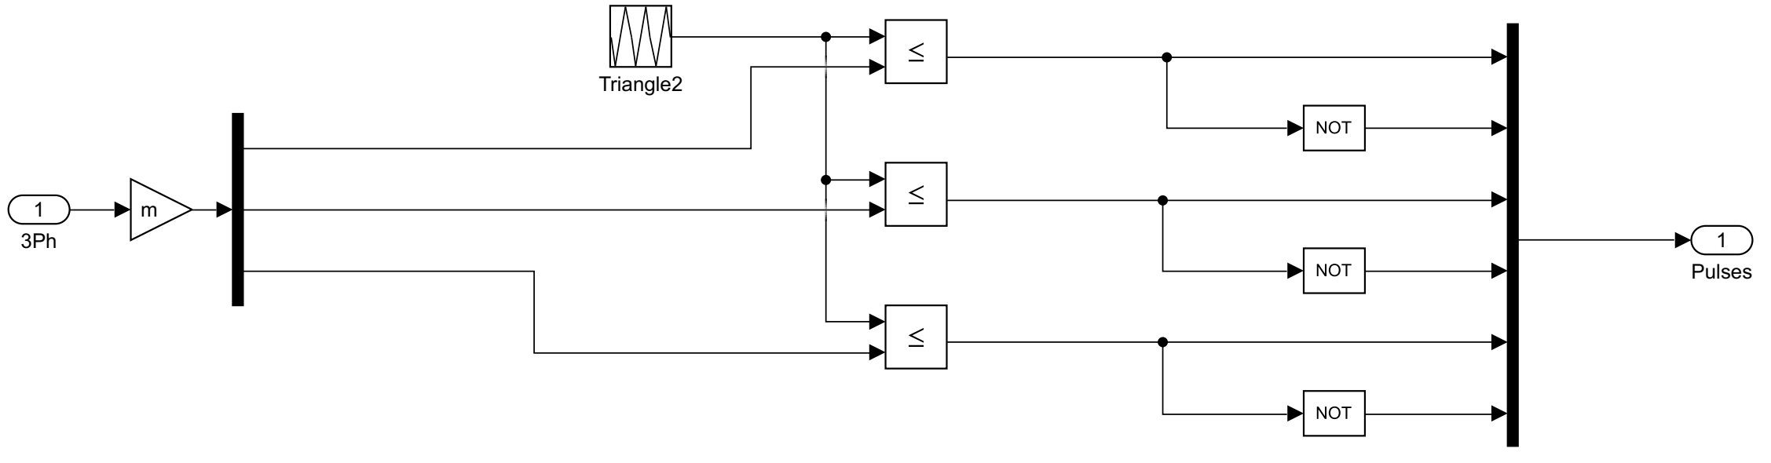
Enhanced IGBT Controller

Slide 22
SST Operation with Different Sources
Photovoltaic Mode & Battery Mode.

Slide 23


Slide 25
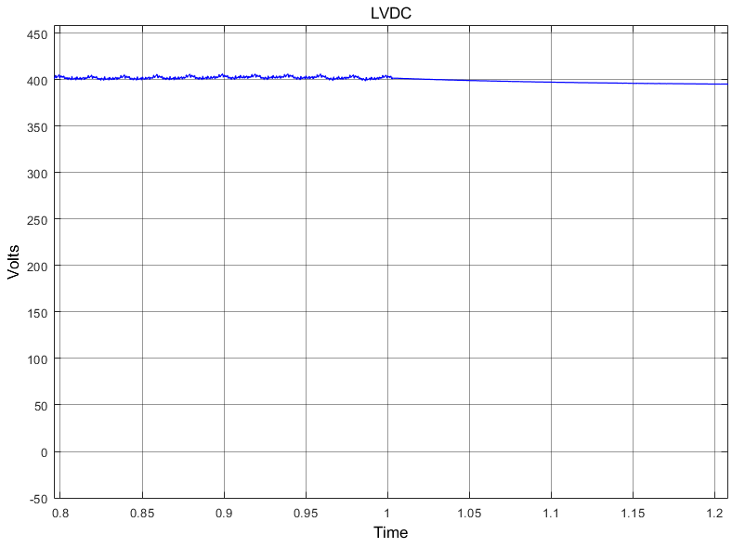
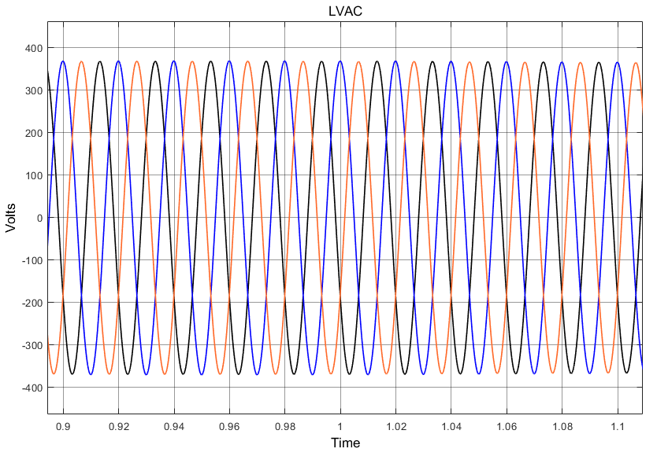
Photovoltaic Mode Results
Stage 2 Stage 3

Slide 26
Battery Mode Results
Stage 2 Stage 3

Slide 27
FREEDM System Simulation
Three bus loop distribution system.

Slide 28
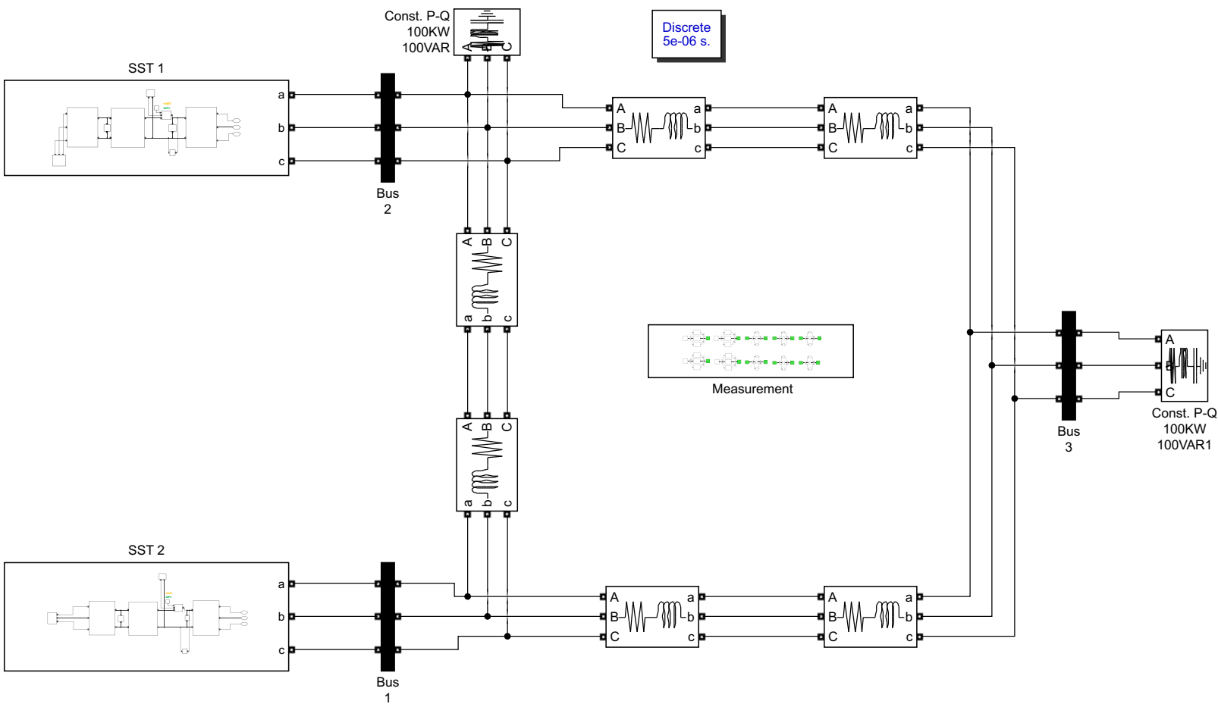

Slide 29
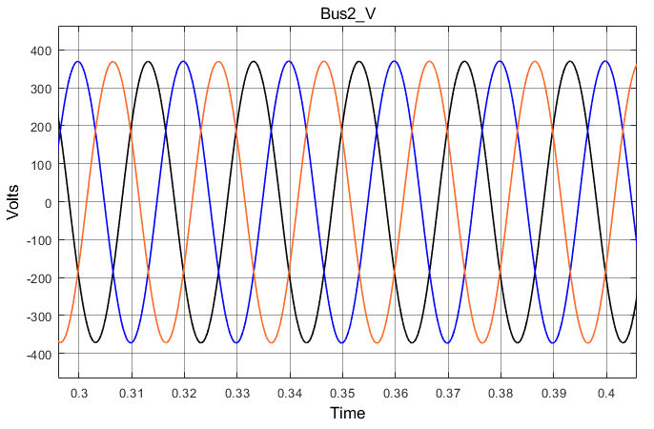
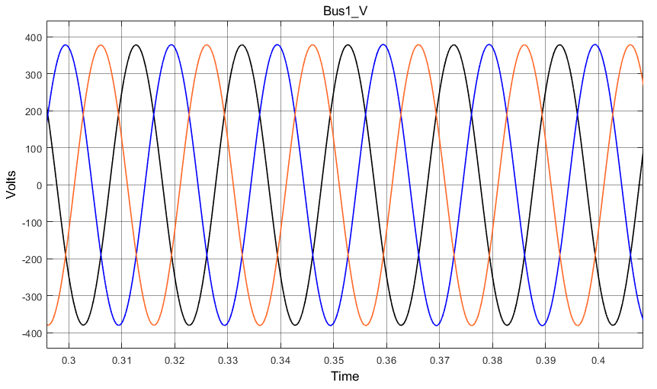
Bus Voltage Results
Bus 2 Bus 1

Slide 30
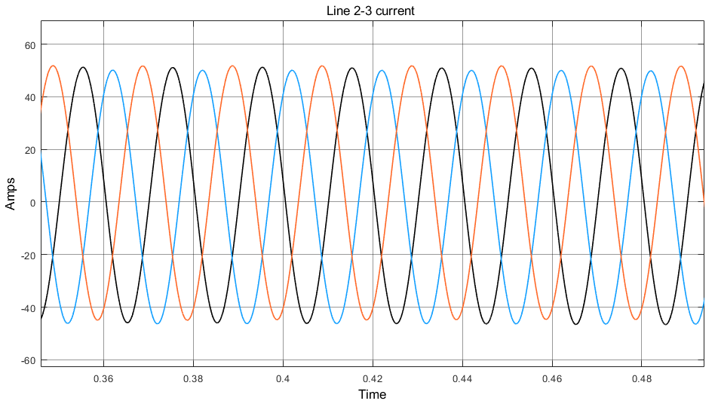
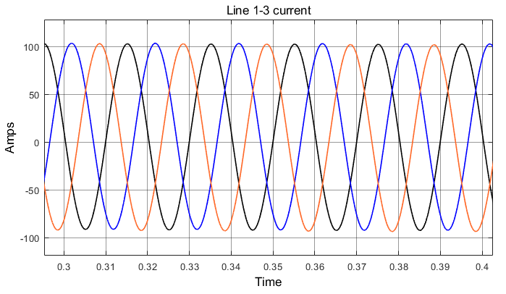
Line Currents Results
Line 2-3 Line 1-3

Slide 31
Protection Schemes
3
Proposed Design and Implementation.

Slide 32
Why Protection?
The power system is subject to constant disturbances.
Maximizing the lifespan for equipment.
The quickness of response is an essential element, response time of the order of a few milliseconds are often required.

Slide 33
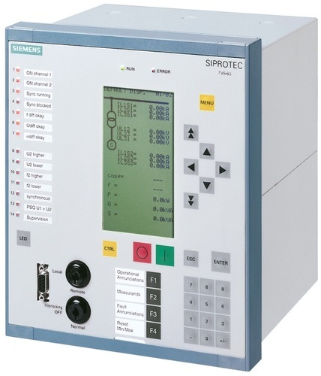
Fault Isolation Device
Ultra-fast compared to traditional circuit breaker.
SSFID with IGBTs in series and Diodes.

Slide 35
At Fault Operation
Severe effects without protection system.
Notes:
simulation

Slide 37
Current at line 1-2
Three phase to ground fault
Voltage at line 1-2
Notes:
All the Three Phases to Ground Fault – It is the most severe type of the fault and very rarely occurs in the power system. It occurs due to a breakdown of insulation between all the phases as well as to the earth.

Slide 38
Transmission Line protection
Notes:
simulation

Slide 39
Differential Protection
Notes:
simulation

Slide 40
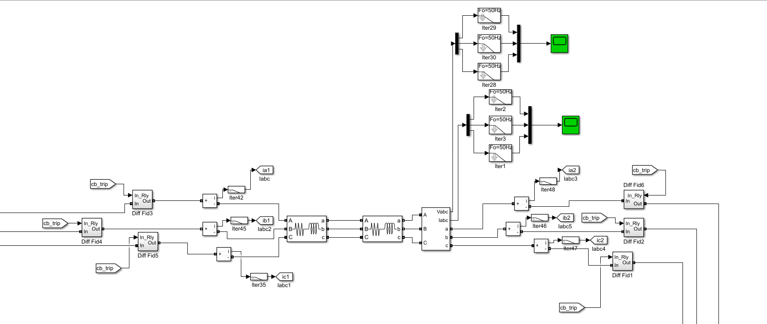

Slide 41
Notes:
All the Three Phases to Ground Fault – It is the most severe type of the fault and very rarely occurs in the power system. It occurs due to a breakdown of insulation between all the phases as well as to the earth.

Slide 42
Current difference at line 1-2
Three phase to ground fault
Current at line 1-2
Notes:
All the Three Phases to Ground Fault – It is the most severe type of the fault and very rarely occurs in the power system. It occurs due to a breakdown of insulation between all the phases as well as to the earth.

Slide 43
Overcurrent Protection
Notes:
simulation

Slide 44
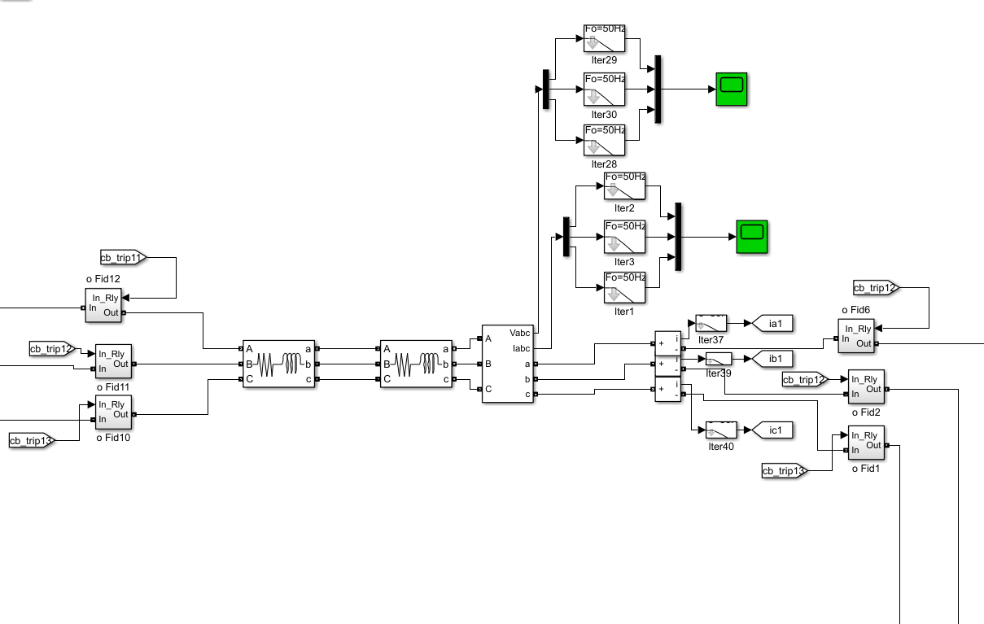

Slide 45
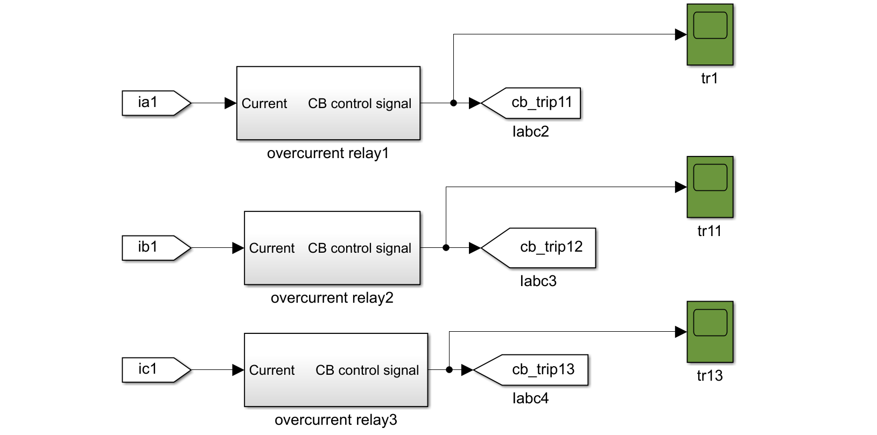
Notes:
All the Three Phases to Ground Fault – It is the most severe type of the fault and very rarely occurs in the power system. It occurs due to a breakdown of insulation between all the phases as well as to the earth.

Slide 46
Main relay block
Notes:
All the Three Phases to Ground Fault – It is the most severe type of the fault and very rarely occurs in the power system. It occurs due to a breakdown of insulation between all the phases as well as to the earth.

Slide 47
Three phase to ground fault
Current at line 1-2
Notes:
All the Three Phases to Ground Fault – It is the most severe type of the fault and very rarely occurs in the power system. It occurs due to a breakdown of insulation between all the phases as well as to the earth.

Slide 48
Integration of IoT
4
The future is here!
Notes:
Smart meters, management , FID , etc
Can we make it real ? Prototype is here!
عصب المشروع بتاعنا
في الاول والاخر احنا بنعمل implementation based on IoT
و زي ما بيقول العنوان , المستقبل وصل!

Slide 49
Internet of Things
A Network in which all physical objects are connected to the internet.
Basically an integration of computing and networking.
Mckinsey Global Institute reports that IoT business will reach 6.2 trillion in revenue by 2025.

Slide 50
IoT in Power Systems
The rise of renewable energy & computerized optimization.
Notes:
نهضة أو ثورة صعد علي اعتبابها الطاقة المتجددة و الحلول الحاسوبية.
كومبيوتر = سرعة وكفائة
To make computers fit in easily

Slide 51
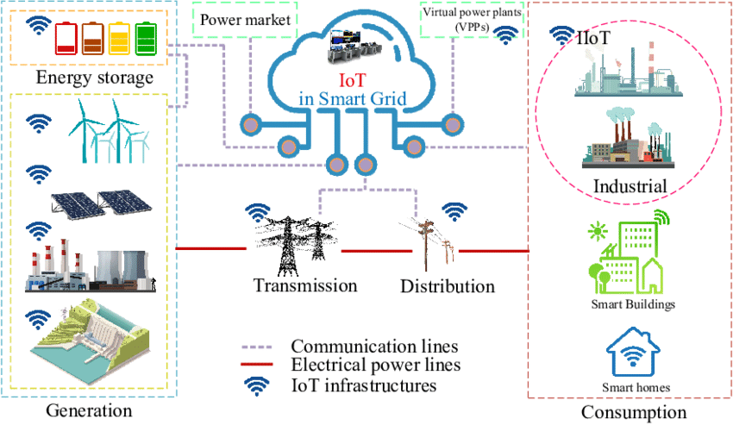
Notes:
Let’s explore an example:
DRER + DESD , Germany harvests 38.5 GW , china 28 GW
Trans + Dist = smart routing
Economic dispatch ( college subjects)

Slide 52
We can split the main functionality:
Distributed Grid Intelligence
System brain. Centralized command and control unit. Gateway to the outside world.
Fault Isolation Device
Computerized protection relay unit. Automated multi-tasking nodes. Ultra-fast and responsive.
Notes:
Dgi can be microcontroller , PC , server , entire cloud!
Gateway = router

Slide 53
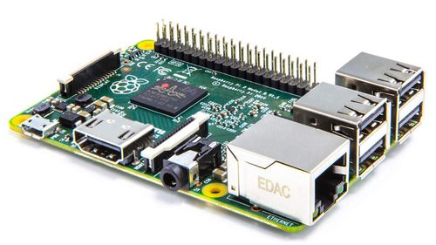
Raspberry Pi 3 Model B+
Cortex (ARMv8) 64-bit @ 1.4GHz.
1 GB RAM.
Gigabit Ethernet + 2.4GHz and 5GHz 802.11.b ac wireless LAN.
Extended 40-pin GPIO header.
5V/2.5A DC power input.
Notes:
Real computer!
OS
Internet

Slide 54
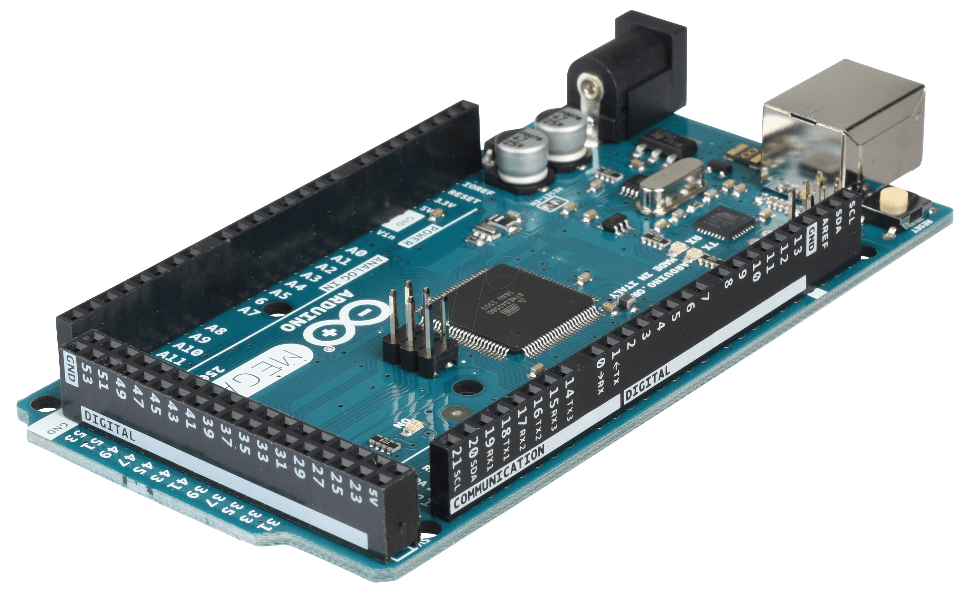
Arduino MEGA
Flash Memory: 256 KB & SRAM: 8 KB
Clock Speed: 16 MHz
Operating Voltage: 5 V
Digital I/O Pins: 54 (of which 15 provide PWM output).
Notes:
Analog pins for sensors
Digital pins for control

Slide 55
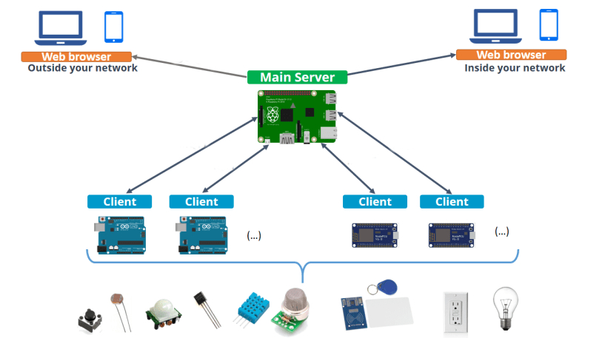
Notes:
سيناريو أبسط

Slide 56
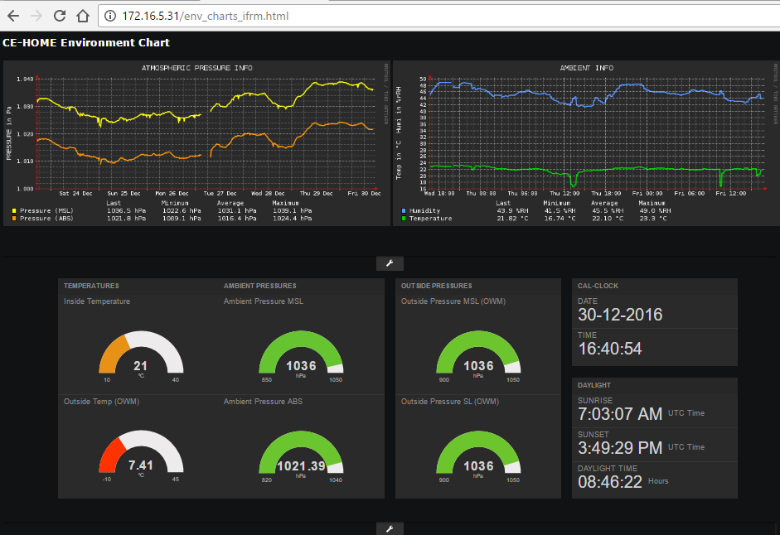

Slide 57
Prototype Design & Implementation
5
Using Proteus software simulator.

Slide 58
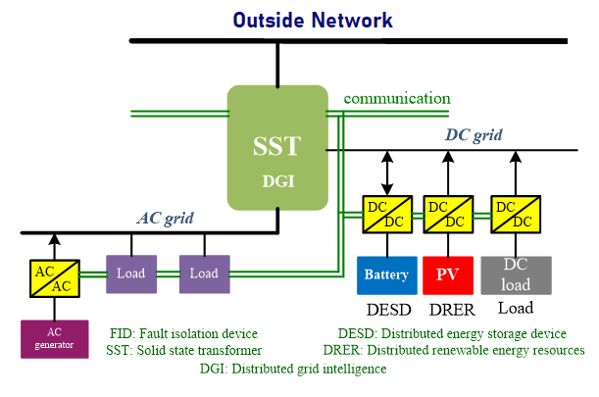

Slide 60
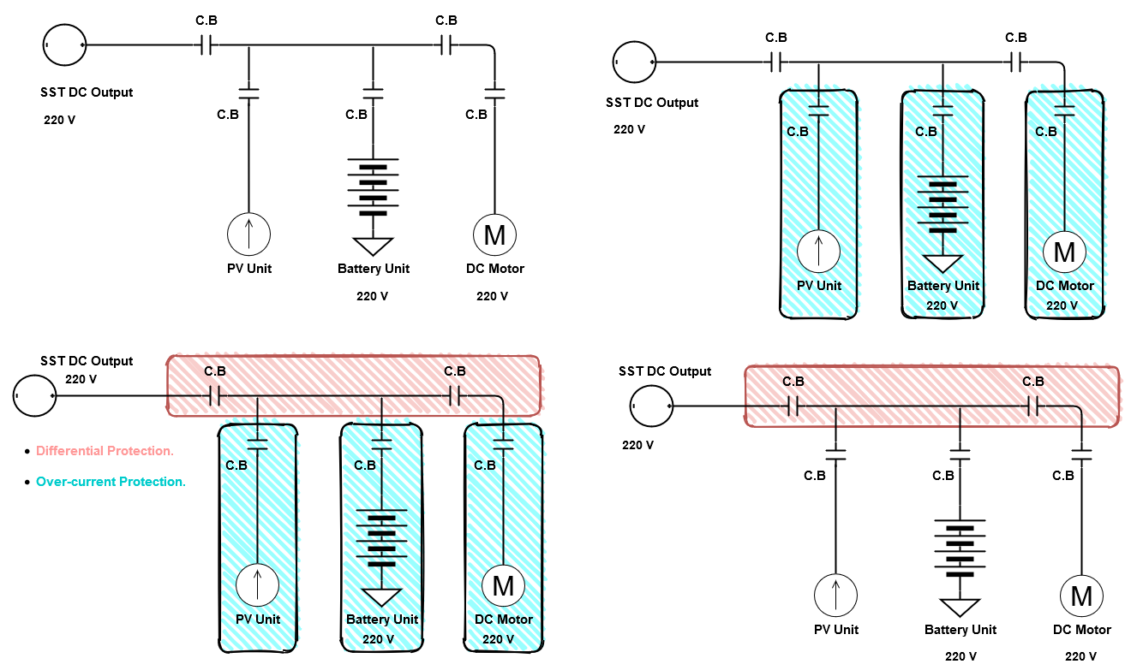
DC Grid Single Line Diagram

Slide 61
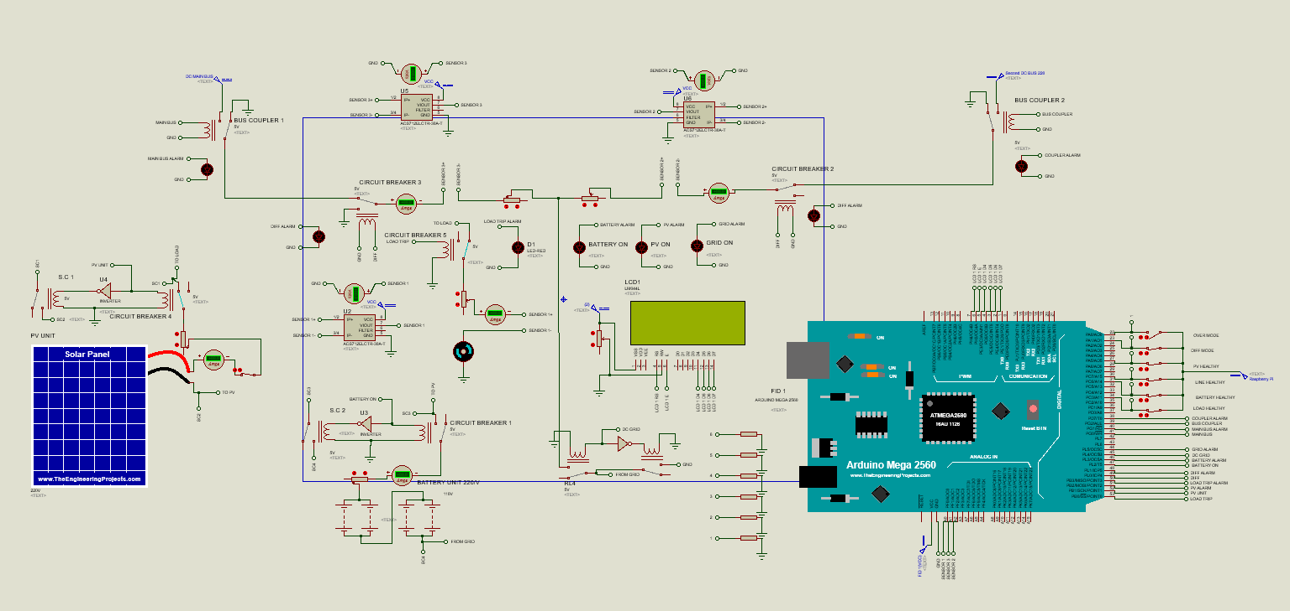

Slide 62
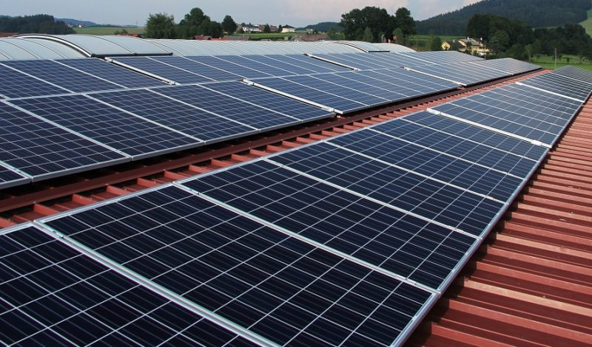
Solar Cell Unit
CO₂-free.
Long lifespan, up to 25 years.
Egypt’s excellent natural advantage.
Notes:
https://en.wikipedia.org/wiki/Benban_Solar_Park
1.6 Nameplate capacity = rated.

Slide 63
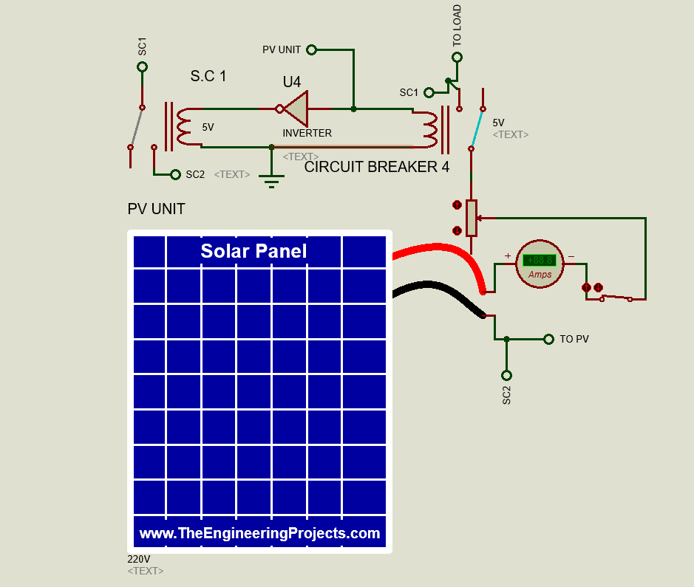

Slide 64
ACS712 Current Sensor
Supply Voltage: 4.5V~5.5V DC
Current Range: -30A~ 30A
Sensitivity: 66mV/A

Slide 65
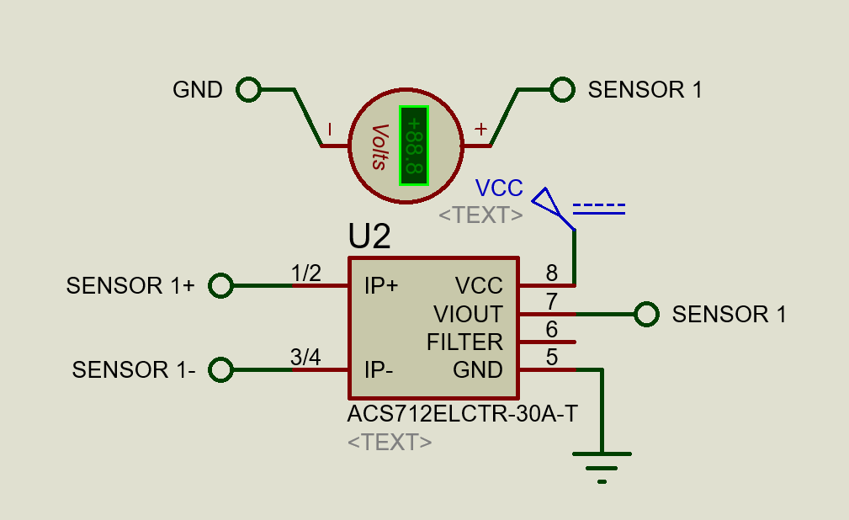

Slide 66
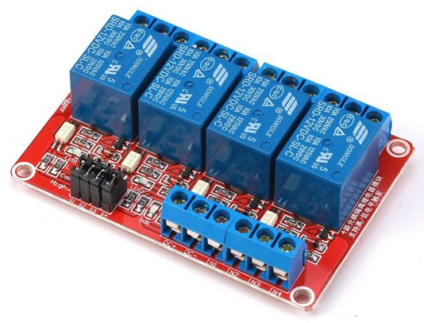
Fault Isolation Device
Operating Voltage: 5 V
Digital I/O Pins: 54 (of which 15 provide PWM output).
Ultra-fast compared to traditional circuit breaker.

Slide 67
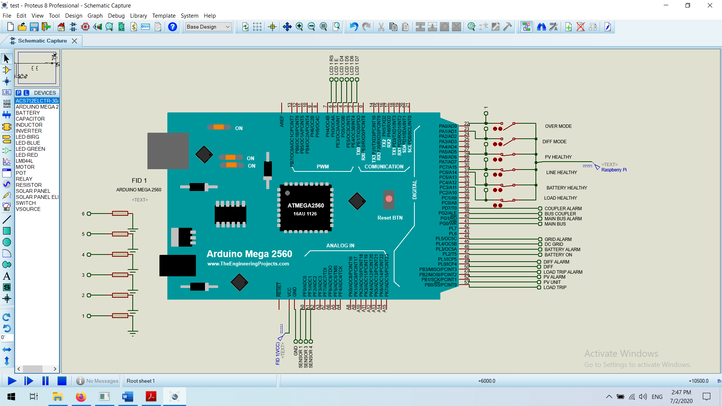

Slide 68
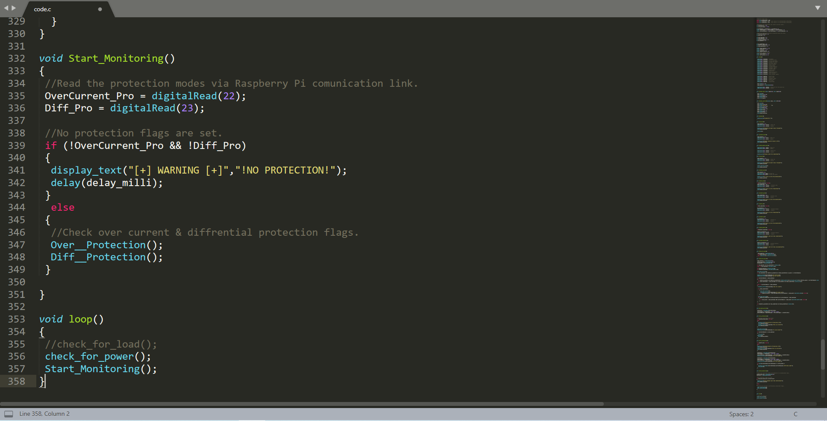

Slide 70
Power Prioritization
The power sources in our FREEDM system is assigned a certain set of rules in order to optimize the load reliability and the economic cost.
PV unit > Battery unit > DC grid.

Slide 71
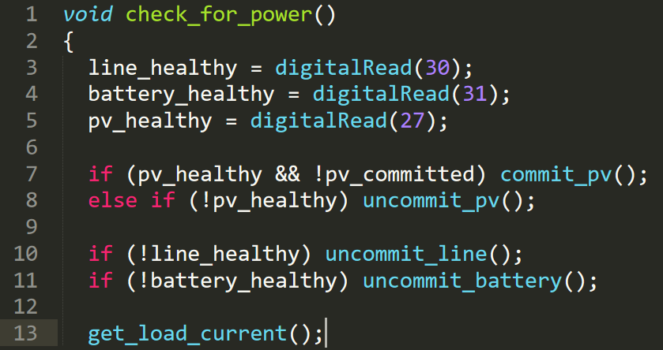

Slide 72
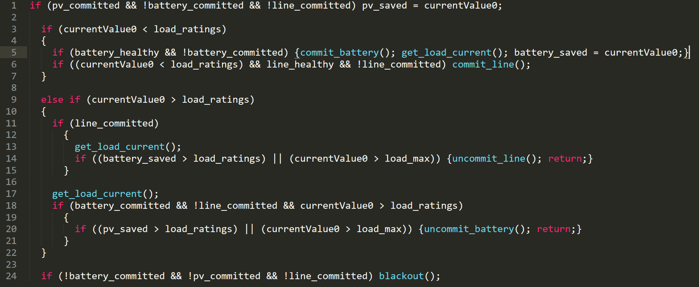

Slide 73
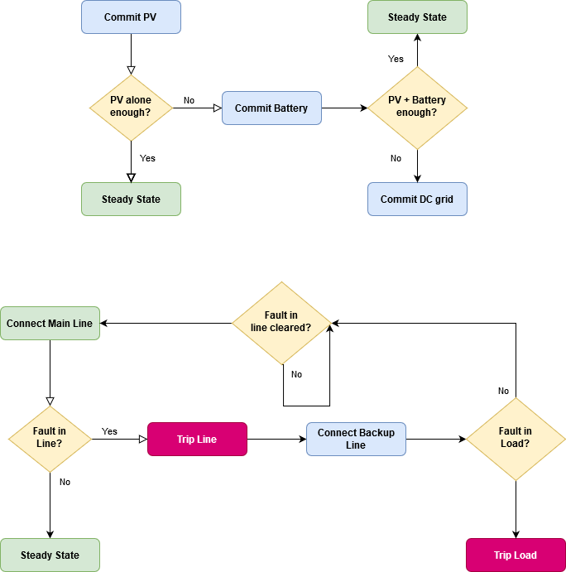

Slide 74


Slide 75
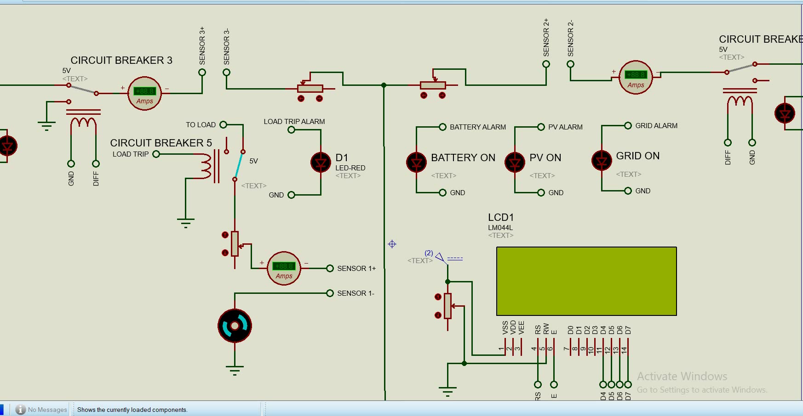

Slide 76
Protection Coordination
Within our system, there two types of protection methods are being used:
- Differential protection for the main line.
- Over current protection for the load. (Backup)
Differential Protection > Over current Protection.
Notes:
An alternative principle for line protection that is quickly becoming the norm is differential protection.
The most important advantage of transmission line differential protection function is unaffected to external faults

Slide 77
Overcurrent Protection Zone

Slide 78
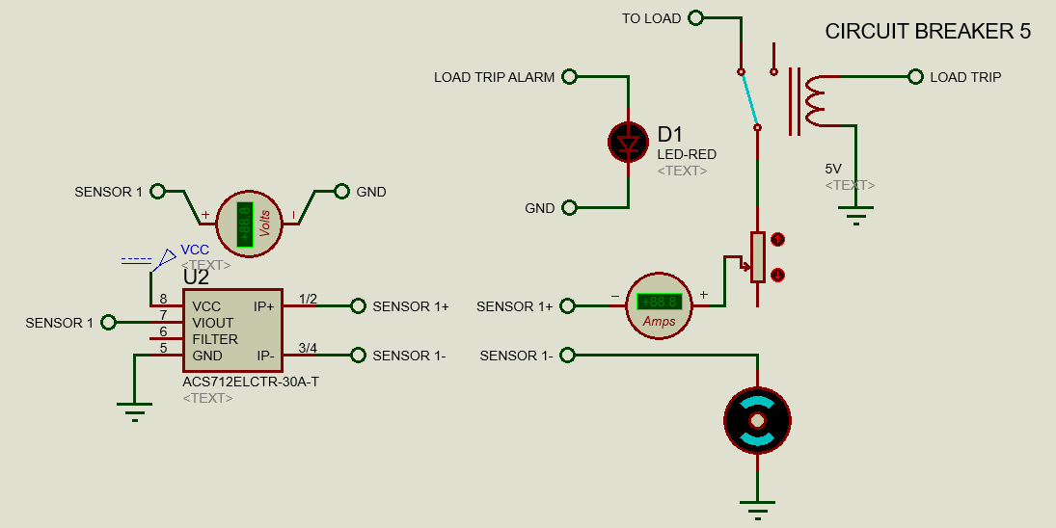
Overcurrent Protection Implementation

Slide 79
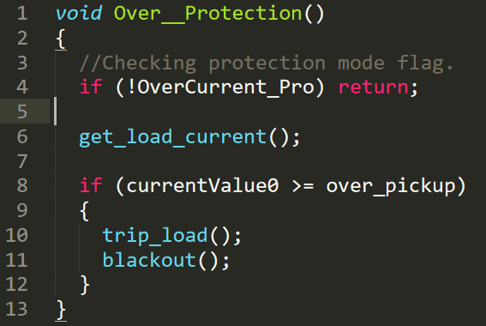

Slide 80
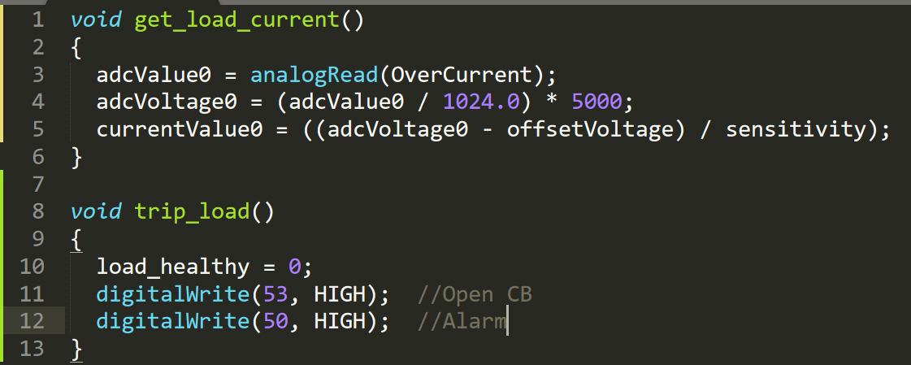

Slide 82
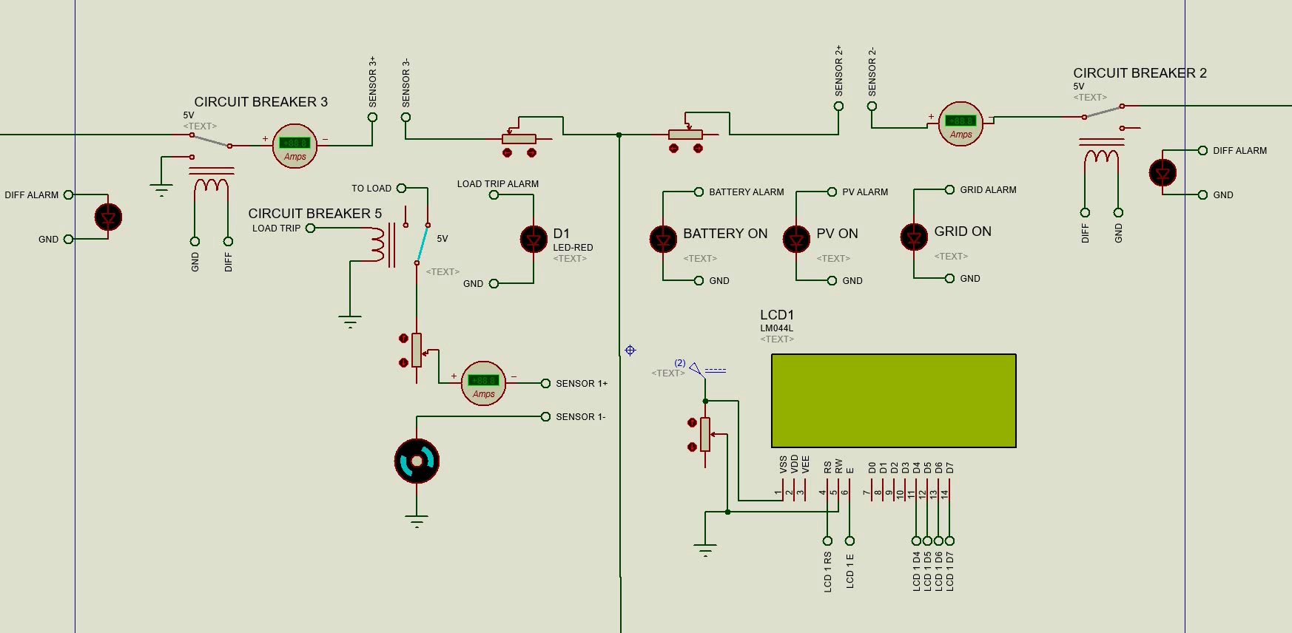

Slide 83
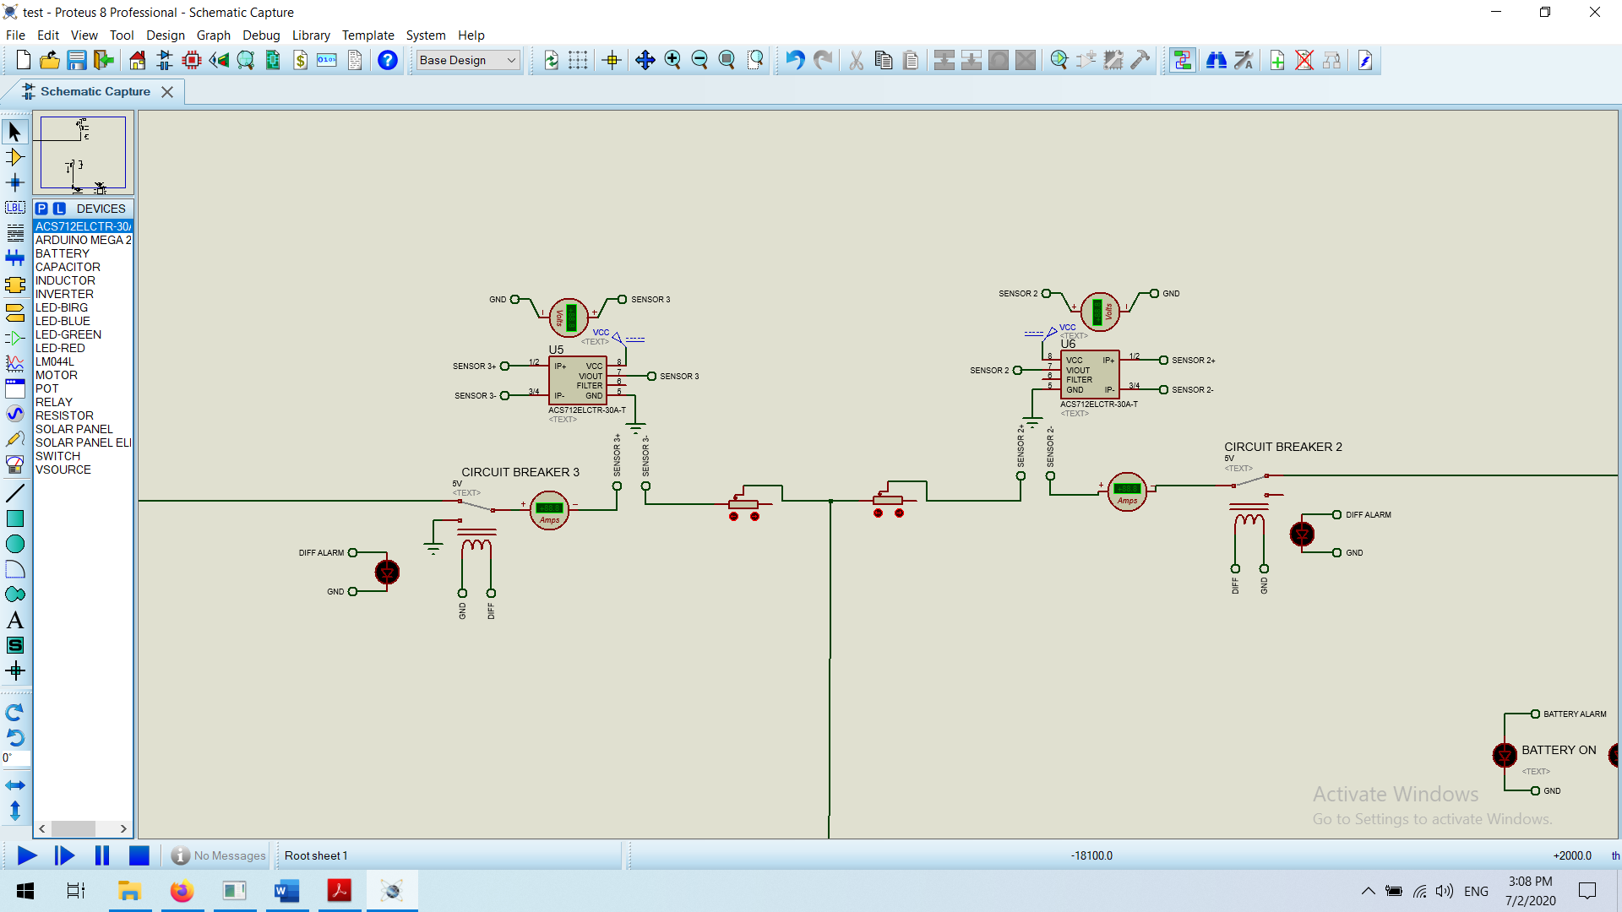
Differential Protection Implementation

Slide 84
Differential Protection Zone

Slide 85
Protection Zones

Slide 86


Slide 87

Future Work
As a consequence of the current COVID-19 pandemic.

Slide 88
The Final big Picture
Plug & Play
Protection Schemes
Management & Control
Cyber Security

Slide 89
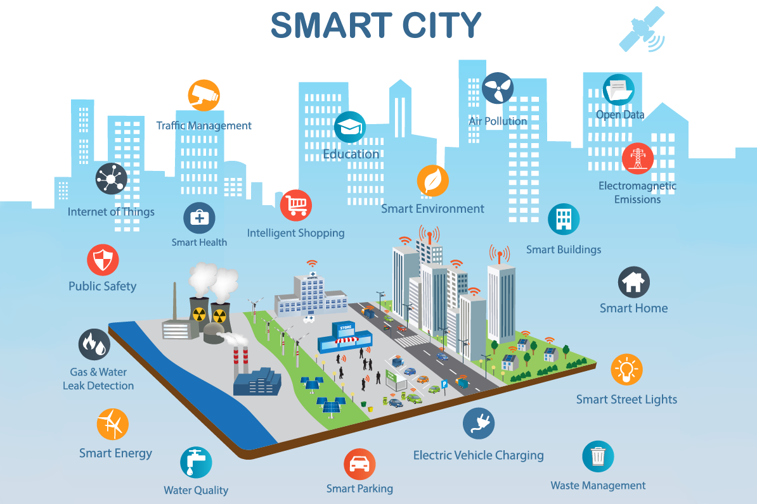

Slide 90
Thanks!
Any questions?

